Slide 1
Linked Lists
Instructors:
Md Nazrul Islam Mondal &
Rizoan Toufiq
Department of Computer Science & Engineering
Rajshahi University of Engineering & Technology Rajshahi-6204

Slide 2
Outline
Introduction
Linked List
Representation of Linked Lists in Memory
Traversing a Linked List
Searching a Linked List
Memory Allocation; Garbage Collection
Insertion into a Linked List
Deletion from a Linked List
Header Linked List
Two Way Lists
Arrays, Records and Pointers

Slide 3
Linked List
Arrays, Records and Pointers

Slide 4
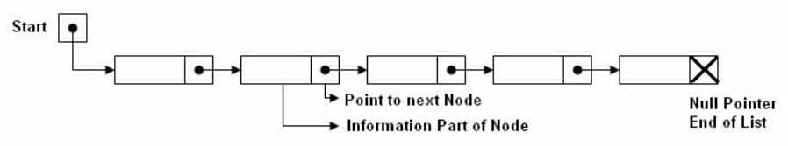
Linked List
A linked list or one way list is a linear collection of data elements, called nodes, where the linear order is given by means of pointers.
Each node is divided into two parts:
The first part - the information of the element/node
The second part- the address of the next node
There is a special pointer Start/List contains the address of first node in the list.
If this special pointer contains null, means that List is empty.
4
Introduction and Overview

Slide 5
Representation of Linked Lists in Memory
Arrays, Records and Pointers

Slide 6
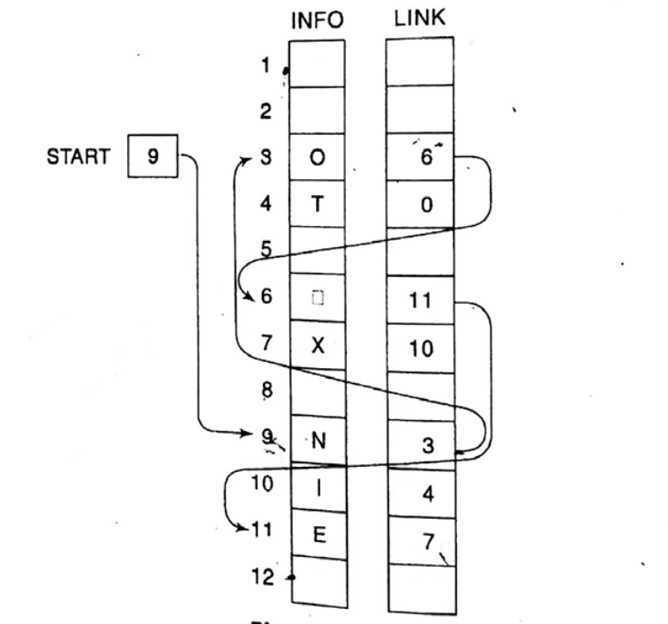
Representation of Linked Lists in Memory
Arrays, Records and Pointers

Slide 7
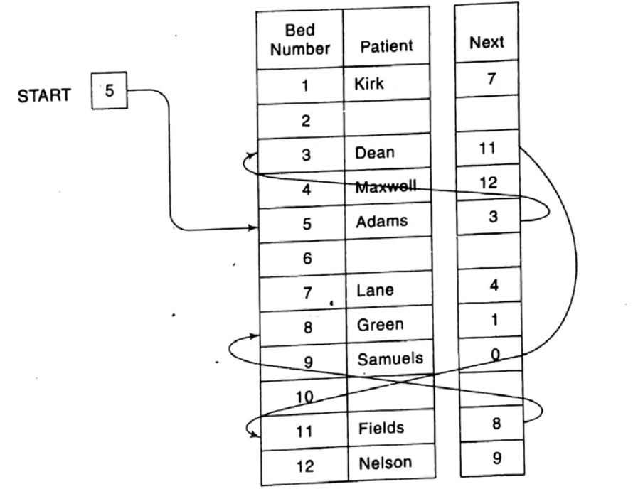
Representation of Linked Lists in Memory
Arrays, Records and Pointers

Slide 8
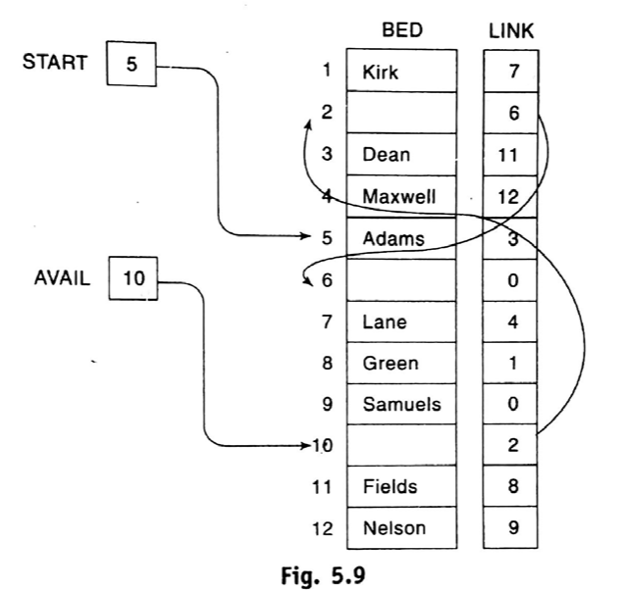
Representation of Linked Lists in Memory
Arrays, Records and Pointers

Slide 9
Create A Linked List
ch = ‘H’
 | INFO | LINK
0 |  | 2
1 |  | 3
2 |  | 4
3 |  | 5
4 |  | 6
5 |  | 7
6 |  | 8
7 |  | 9
8 |  | 1
9 |  | -1
START | -1
AVAIL | 0
Arrays, Records and Pointers

Slide 10
Create A Linked List
 | INFO | LINK
0 |  | 2
1 |  | 3
2 |  | 4
3 |  | 5
4 |  | 6
5 |  | 7
6 |  | 8
7 |  | 9
8 |  | 1
9 |  | -1
START | -1
NEW | 0
AVAIL | 0
AVAIL | 2
AVAIL != NULL, (TRUE)
NEW = AVAIL,
AVAIL = LINK[AVAIL]
Arrays, Records and Pointers

Slide 11
Create A Linked List
START | -1
 | INFO | LINK
0 | H | -1
1 |  | 3
2 |  | 4
3 |  | 5
4 |  | 6
5 |  | 7
6 |  | 8
7 |  | 9
8 |  | 1
9 |  | -1
START | 0
PTR | 0
NEW | 0
AVAIL | 2
INFO[NEW] = ‘H’
LINK[NEW ] = -1
START == -1 (TRUE)
START = NEW
PTR = START
Arrays, Records and Pointers

Slide 12
Create A Linked List
 | INFO | LINK
0 | H | -1
1 |  | 3
2 |  | 4
3 |  | 5
4 |  | 6
5 |  | 7
6 |  | 8
7 |  | 9
8 |  | 1
9 |  | -1
START | 0
PTR | 0
NEW | 0
NEW | 2
AVAIL | 2
AVAIL | 4
AVAIL!=NULL (TRUE)
NEW = AVAIL
AVAIL = LINK[AVAIL]
Arrays, Records and Pointers

Slide 13
Create A Linked List
ch = ‘I’
 | INFO | LINK
0 | H | -1
1 |  | 3
2 | I | -1
3 |  | 5
4 |  | 6
5 |  | 7
6 |  | 8
7 |  | 9
8 |  | 1
9 |  | -1
START | 0
2
PTR | 2
PTR | 0
NEW | 2
AVAIL | 4
INFO[NEW] = ‘I’
LINK[NEW ] = -1
START == -1 (FALSE)
LINK[PTR] = NEW;
PTR = NEW
Arrays, Records and Pointers

Slide 14
Available Memory Check
Algorithm: (Check Memory Overflow) This algorithm check available memory.
[OVERFLOW] If AVAIL = NULL, then: Write: OVERFLOW, and Exit
[Remove first node from AVAIL.]
Set NEW:=AVAIL and AVAIL := LINK[AVAIL]
Exit
Arrays, Records and Pointers

Slide 15
Create A Linked List
Algorithm: (Create a Linked List) This algorithm create a linked list with n nodes.
START := NULL
Repeat Steps 3 to 5 for I = 1 to N
[OVERFLOW] If AVAIL = NULL, then: Write: OVERFLOW, and Exit
[Remove first node from AVAIL.]
Set NEW:=AVAIL and AVAIL := LINK[AVAIL]
Set INFO[NEW] := ITEM and LINK[NEW] := NULL
If START = NULL, then:
Set START := NEW and PTR : = START
Else:
Set LINK[PTR] := NEW and PTR = NEW
[End of If structure]
Exit
Arrays, Records and Pointers

Slide 16
Create a Linked List Using Array
Arrays, Records and Pointers

Slide 17
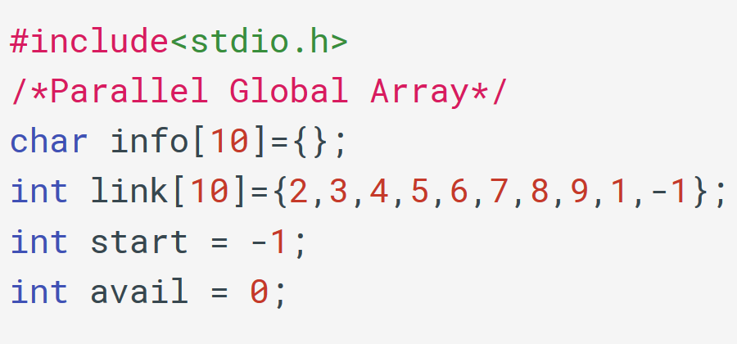
Create a Linked List Using Array
Arrays, Records and Pointers

Slide 18
Create a Linked List Using Array
 | INFO | LINK
0 |  | 2
1 |  | 3
2 |  | 4
3 |  | 5
4 |  | 6
5 |  | 7
6 |  | 8
7 |  | 9
8 |  | 1
9 |  | -1
AVAIL | 0
Arrays, Records and Pointers

Slide 19
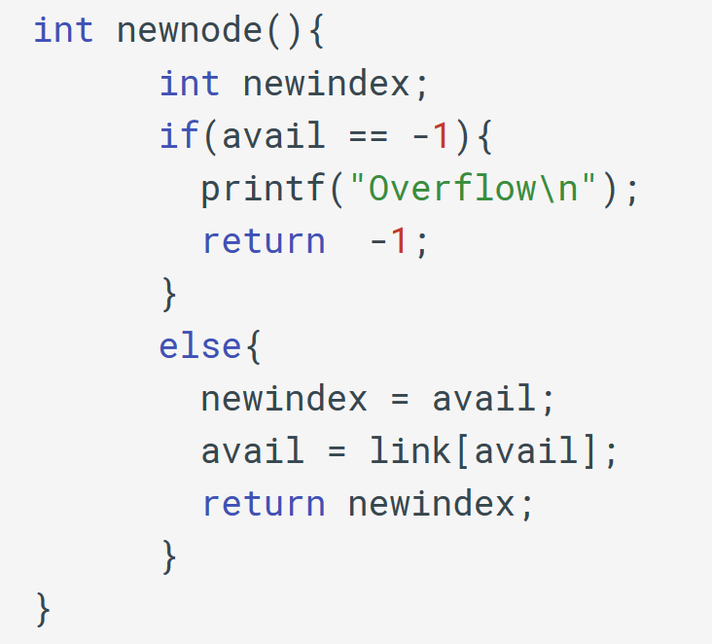
Create a Linked List Using Array
Arrays, Records and Pointers

Slide 20
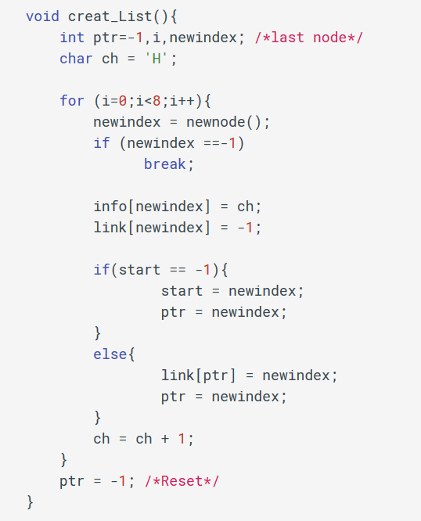
Create a Linked List Using Array
Arrays, Records and Pointers

Slide 21
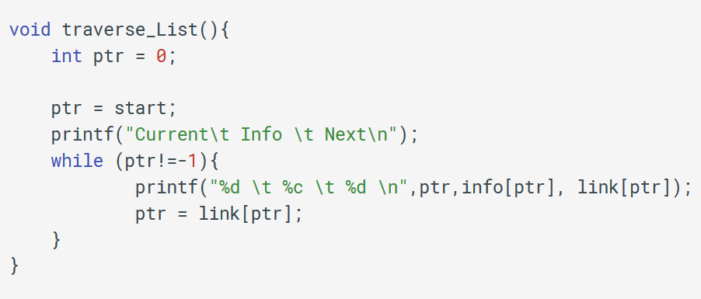
Create a Linked List Using Array
Arrays, Records and Pointers

Slide 22
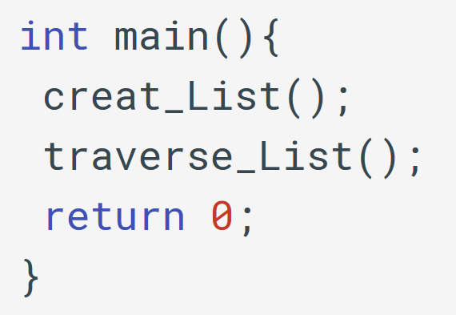
Create a Linked List Using Array
Arrays, Records and Pointers

Slide 23
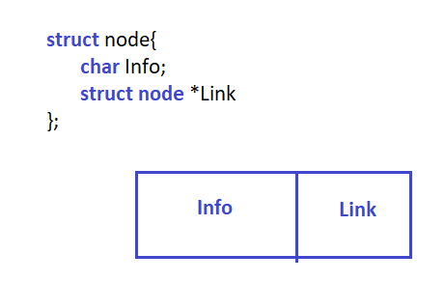
Create a Linked List Using Structure
Arrays, Records and Pointers

Slide 24
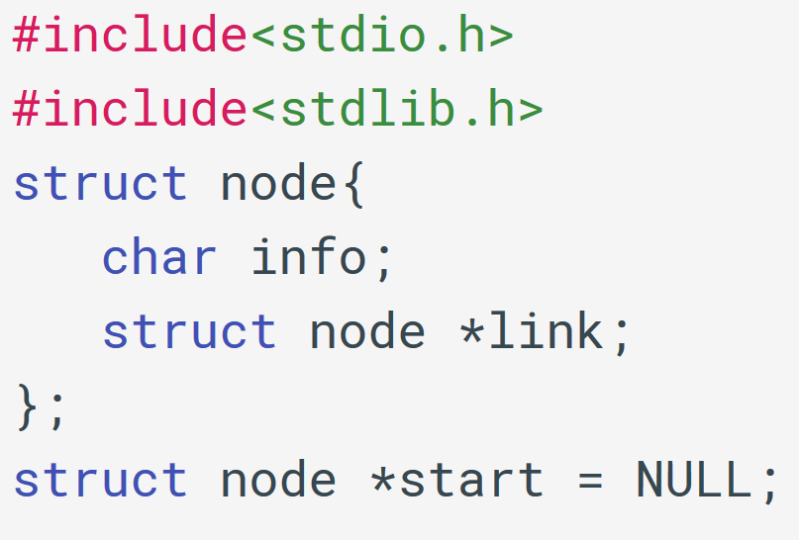
Create a Linked List Using structure
Arrays, Records and Pointers

Slide 25
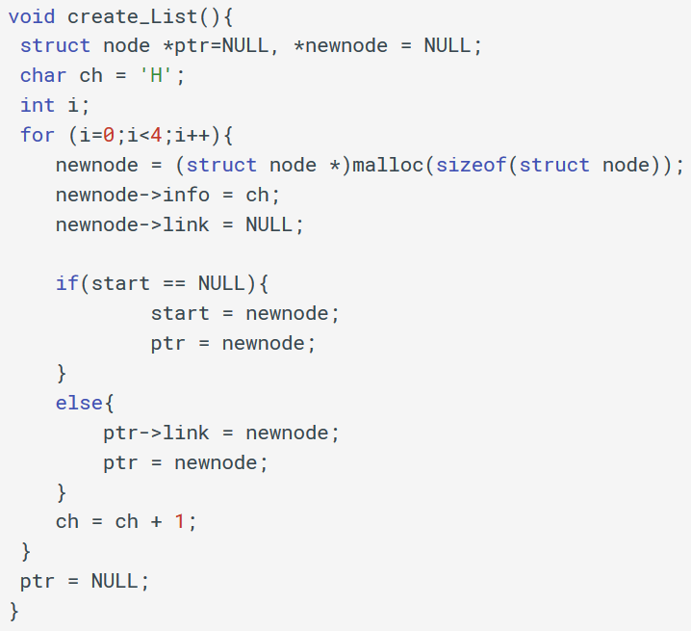
Create a Linked List Using Structure
Arrays, Records and Pointers

Slide 26
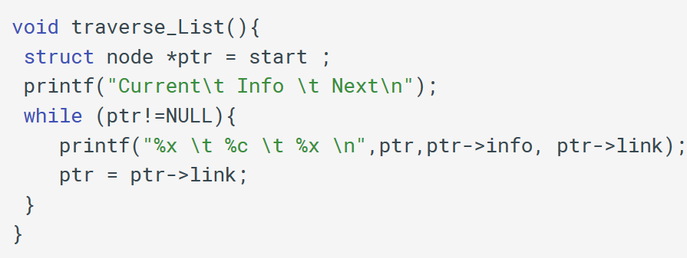
Create a Linked List Using Structure
Arrays, Records and Pointers

Slide 27
Create a Linked List Using Structure
Arrays, Records and Pointers

Slide 28
END
Arrays, Records and Pointers

